Slide 1

UNM Study Abroad Programs
“When we enlarge our view of the world, we deepen our understanding of our own lives.”
Yo-Yo Ma, Artistic Director, The Silk Road Project, Inc.

Slide 2

"There are two types of education.
One should teach us how to make a living, And the other how to live."
--John Adams

Slide 3

IMPORTANT INFORMATION:
BEFORE You Leave
Submit your itinerary, health insurance, signature documents and a copy of your passport online to GEO.

Slide 4
IMPORTANT INFORMATION:
UPON ARRIVAL & Throughout Your Stay
Add your new address and phone number to your online application or e-mail us your information (studyabd@unm.edu), so we can contact you in an emergency
Find the nearest U.S. consulate – www.travel.state.gov
Visit the website for the State Department & Center for Disease Control (CDC) frequently to check for Travel Warnings and Public Announcements: http://travel.state.gov & http://www.cdc.gov/
Keep your study abroad/health insurance current for the entire time you are away, i.e., if you extend your stay, be sure to extend your insurance policy until the date you return
Please check your e-mail daily or as often as possible, in case we are trying to reach you. If your e-mail address changes, let us know immediately

Slide 5
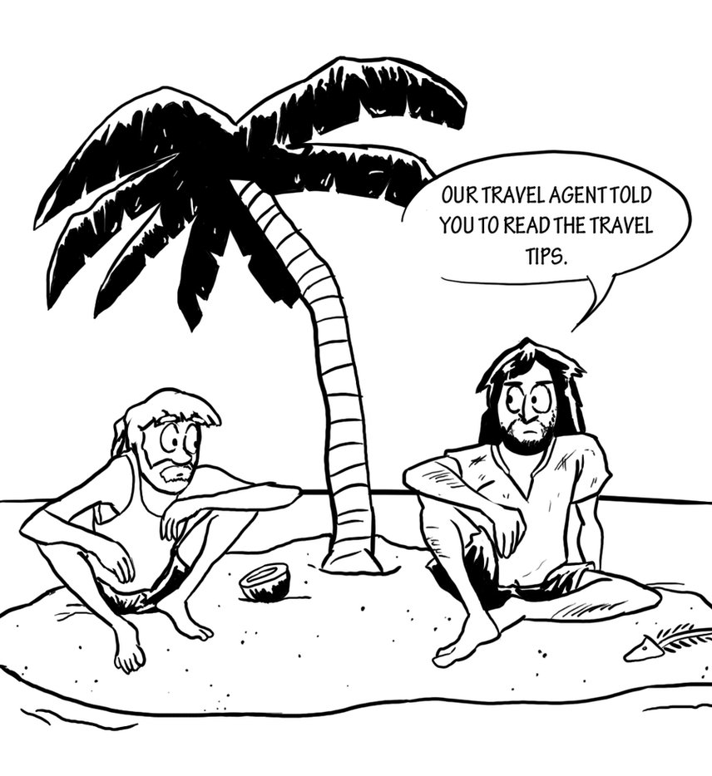
Register in STEP
(Smart Traveler Enrollment Program)
Whenever you travel outside the U.S. you should register your information on-line in the U.S. State Department STEP program. This will allow U.S. Embassy staff to send you security updates and information about the countries you are visiting and to locate you in case of a natural disaster or other emergency.

Slide 6
How to Register with STEP:
Go to https://step.state.gov/step/
Create an individual account and log in
Fill out profile information
Fill out trip dates and locations
Confirm – you should receive confirmation email
You will receive updates and warnings if from the nearest consulate

Slide 7

IN CASE OF AN EMERGENCY
Contact GEO - 505-277-4032
Study Abroad Advisors
Ken Carpenter - Director of Education Abroad, carpenk@unm.edu
Alex Zimmerman - Study Abroad Advisor, alexz@unm.edu
Annette Mares-Duran - Study Abroad Advisor, amares2@unm.edu
Susi Knoblauch - Study Abroad Advisor, chknob@unm.edu
Kenny Gaona - Study Abroad Student Employee, studyabd@unm.edu
You can also Contact Other Important Offices:
Office of the Provost 505-277-2611
Dr. Chaouki Abdallah, Provost
Dean of Students 505-277-3361
Tomás Aguirre, Dean of Students
* Contact the UNM Police (24 hours/day) 505-277-2241

Slide 8
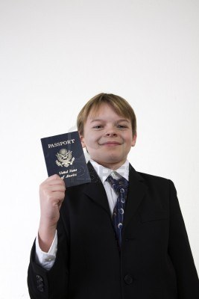
REQUIREMENTS FOR ENTERING
THE HOST COUNTRY
Passport
Student Visa
  Round-trip Itinerary
  Proof of Housing
  Proof of Adequate Finances
  Health Insurance
  Acceptance Letter to Host University

Slide 9
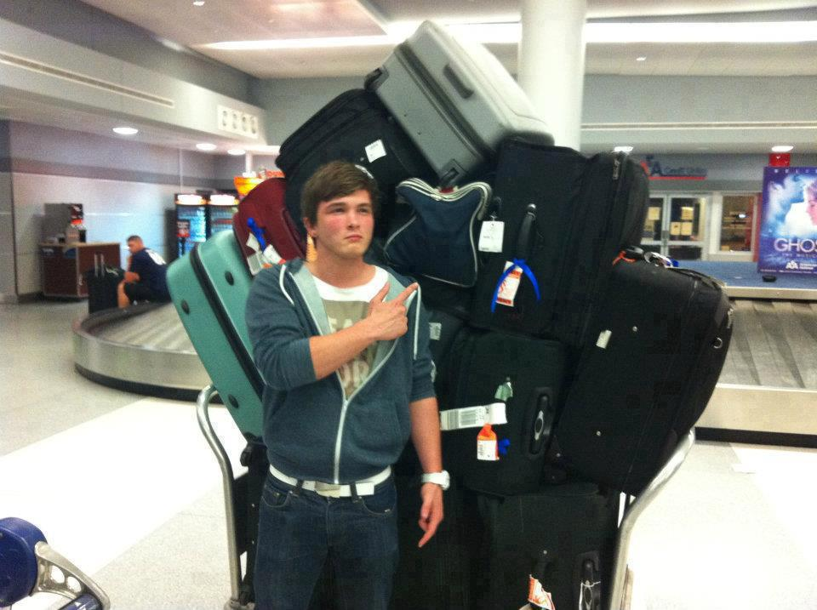
“Educational exchange can turn nations into people, contributing as no other form of communication can to the humanizing of international relations.”
--J. William Fulbright
TRAVEL INFORMATION

Slide 10

Getting There by Air:
UNM study abroad participants recommend the following sites for discounted airfares:
- www.studentuniverse.com
- www.sta.com
- www.mobisimo.com
- www.kayak.com
- www.sidestep.com
- www.vayama.com
- www.flycheapo.com
- www.cheapoair.com
Around the World Tickets
Most American students are unfamiliar with ATW tickets, but it looking into. Most ATW tickets will grant you a full year to travel to three or more continents and can be quite reasonable in comparison with the price of other tickets. If you are planning on doing some major traveling, look into it.

Slide 11
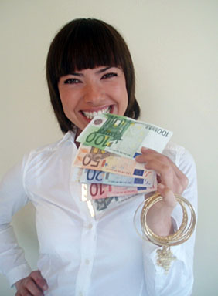
Travel Money Saving Tips:
Start early
Contact a travel agent
Be flexible, with travel dates, destinations, etc.
Use public transportation (it might offer you a better, more affordable option than a taxi)

Slide 12

HEALTH INSURANCE
The UNM Provost’s office mandates that you have special travelers insurance to participate in our study abroad programs.
In order to be excluded from purchasing this “special insurance” you must provide proof to our office that your current insurance company (i.e. your parents’ plan) provides:
1) Medical Coverage of at least $50,000
2) Emergency Medical Evacuation
3) Repatriation of Remains

Slide 13
HTH Worldwide Health Insurance
Unless you are required to buy a specific type of insurance by your host university or country, UNM recommends that students purchase HTH Worldwide health insurance.
Why Have International Travel Health Coverage?
While some regions, like the United Kingdom, might automatically incorporate you into their national healthcare system, events like medical evacuation or repatriation of remains will NOT be covered; therefore, UNM requires that all students purchase a plan that offers this coverage.

Slide 14

HEALTH INSURANCE:
Enroll on-line at www.hthstudents.com
UNM Group Discount Code: CSZ-5241
Upload your proof-of-enrollment document on your online application.
HTH Worldwide costs ~$41/month for students under 30 years of age and must be purchased in one-month increments (for example Jan 1st to June 1st, or August 30th to December 30th);
You must have insurance for your ENTIRE length of stay in the country where you plan to study abroad.
UNM Student Health Insurance holders: Please send us a copy of your insurance card, with expiration date/s listed.
NOTE: Some visa applications require you to submit an official letter from the international travel health group to prove your insurance while abroad, so it is important to enroll several weeks before you plan to apply for a student visa.
WE MUST HAVE PROOF OF INSURANCE BEFORE YOU LEAVE FOR STUDY ABROAD
-NO EXCEPTIONS-

Slide 15
Preparedness
Always carry a photo ID with you and the names and numbers of persons to contact in case of an emergency;
Fill out an “EMERGENCY CARD” and carry it with you at all times;
Give us your current email, home address and phone number when you arrive in your host country. This is essential nowadays, due to the heightened sense of security both abroad and in the US;
Stay in touch with your study abroad office as much as possible.

Slide 16
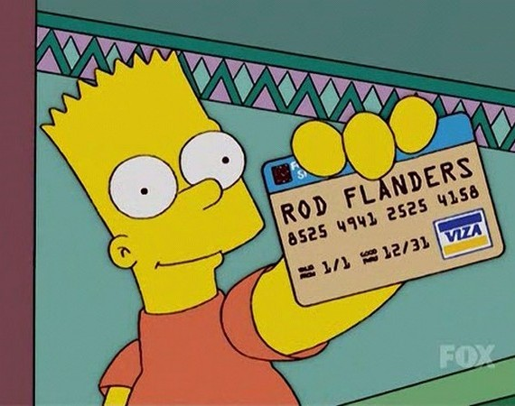
Finances
Scholarship/Financial Aid disbursement
Bursar payments
Use ATM card
Bring 1-2 major credit cards instead of carrying large amounts of cash
Know the exchange rates and consider changing a small amount of money before you leave (most banks can do this).
Power of Attorney Form

Slide 17
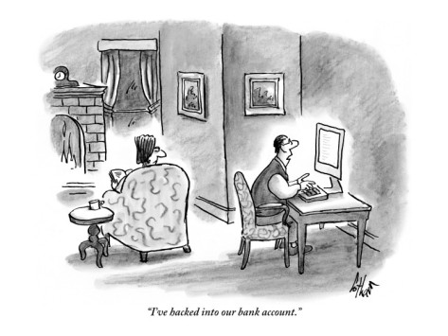
Laptop Security
TIPS TO KEEP YOUR LAPTOP AND YOUR PRIVATE INFORMATION SAFE
Limit personal data to what is needed for travel purpose
Encrypt and/or password protect data
Back up all data before leaving home
Ensure antivirus software is current and working properly
Ensure all software patches are applied
Notes:
1. Leave at home unless critical to your mission;
2. Only take data that is needed for travel purpose -- SCRUBBING
3. Record serial and model number (leave at home as well)
4. PCL’s : IT department can set up virtual private network (VPN) that allows you to send emails and use the web while travelling
Don’t leave laptop unsecure in room; lock in luggage out of plain view or lock it to fixed object
5. Carry in backpack -- unexpected

Slide 18


Cell Phone Security
CELL PHONES CONTAIN:
  Personal data, bank and credit card account information
  Intellectual property
  Calendar information
  GPS – Geotagging – photos can give away your location
  *Do not post photos on Facebook while traveling
  A unique factory setting serial number
  * Scam artists can reprogram (clone) phone to charge calls and texts to your bill
  * Signs your phone was cloned:
  Phone calls and texts not received
  Incoming calls go straight to voicemail
  Cell phone battery suddenly drains
Do not allow strangers to use your cell phone
Consider purchasing disposable cell – provide phone number
Notes:
4. If you take a photo with cell phone – GPS can give your location away (NOT good if you post photos on FB while traveling. )
5. UNIQUE FACTORY SET Every cell phone has a unique factory setting serial number. (Like VIN on a car)
Scam artists can reprogram/ “clone” their phone to use your VIN and charge texts and calls to your phone bill
Signs that your cell phone was cloned:
Phone and texts are not received
Incoming calls go straight to voicemail
Cell phone battery suddenly drains

Slide 19

Questions?

